Slide 1
Microbiology Dep.
Second year
Parasitology
7th Lec.
Lecturer: Assist prof.
Dr.Sally Ahmed
Haemosporidia
Subphylum: Apicomplexa.
Class Sporozoea
Order Eucoccidia
Genus: Plasmodium.
• There are 4 species of the genus plasmodium that infect human, these are:
1) Plasmodium vivax (benign tertian malaria)
2) Plasmodium ovale (ovale tertian malaria)
3) Plasmodium falciparum (malignant tertian malaria)
4) Plasmodium malariae (quartan malaria).
• The disease caused by the genus plasmodium is called Malaria.
• Genus plasmodium require 2 hosts for the life cycle, the intermediate host which is the vertebrate host where asexual phase develop and the definitive host which is the female of Anopheline mosquitoes where sexual phase develop.

Slide 2
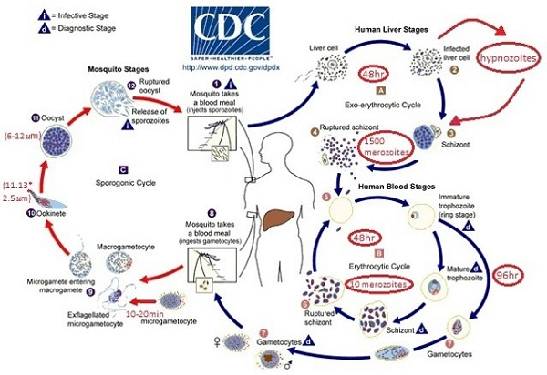
Life cycle
Life cycle of plasmodium

Slide 3
Pathogenesis
The pathogencity of malaria is related to RBC infection. Tissue destruction in exoerythrocytic cycle appears not to produce sign and symptoms. The plasmodia in RBC grow and segment at the expense of the host cells and the malarial parasite progressively consumes and degrades intracellular proteins, the hemoglobin. The potentially toxic heme is polymerized to biologically inert hemozines or malarial pigment. Plasmodium falciparum infects RBC at all ages. Plasmodium vivax and ovale infects only reticulocytes. Plasmodium malariae infects only mature RBC.
All species of Plasmodium caused:
Anemia.
Chills and fever of malarial attack.
Spleen is enlarged.
Infection with P.falciparum differs from the other types.
a) It invades erythrocytes of all ages and thus causing very extensive parasetemia.
b) The schizogonic cycle in the bloodstream requires 36-48 hrs.
c) There is a tendency for more than one parasite to develop in a single RBC.

Slide 4
Diagnosis
1) Microscopic
Thick and thin blood films.
2) Serological test:
a) Indirect fluorescent antibody test (IFAT),
b) Indirect hemagglutination antibody (IHA) test,
c) Enzyme-linked immunosorbent assay (ELISA).
3) Molecular biological detection tests:
DNA and RNA probes and polymerase chain reaction (PCR) have good sensitivity and specificity.
Prevention and control
1) Chemoprophylaxis
2) Mosquitoes nets, windows screen, protective clothes and insects repellents.
3) Drainage of stagnant water in swamps and ditches decreasing the breeding areas.

Slide 5
Genus Toxoplasm
Subphylum Apicomplexa
Class Sporozoea
Order Eucoccidia
Genus Toxoplasma
Species: Toxoplasma gondii
• Toxoplasma gondii is a coccidian parasite of cosmopolitan distribution, able to develop in a wide variety of vertebrate hosts, but the definitive host is the house cat and certain felidae.
• The definitive host is the house or domestic cat and other felidae.
Intermediate host: man (considered as a dead end host) and other mammals (cattle, sheep, mouse and pig).
Morphology
There are five forms in T. gondii life cycle:
1- Trophozoite (tachyzoite),
2- Tissue cyst (bradyzoite),
3- Schizont
4- Gametocyte
5- Oocyst .

Slide 6
Pathogenesis:
The bradyzoites when released from ruptured tissue cysts cause local
inflammation with blockage of blood vessels and necrosis.
Congenital toxoplasmosis:
• Congenital infection of the fetus occurs only when the mother is infected during pregnancy.
diagnosis
1.Smears from Lymph node, bone marrow, spleen. For organism detection.
2. Serological test
Indirect fluorescent antibody (IFA) test and ELISA test including IgM and IgG kits.
3. Molecular diagnosis by PCR.
Prevention:
* Meat cooked to 50-60 Cº for 4 – 6 minutes or freezing at – 20 Cº for 48 hours.
* Pregnant mother should avoid all contacts with cats.

